Slide 1

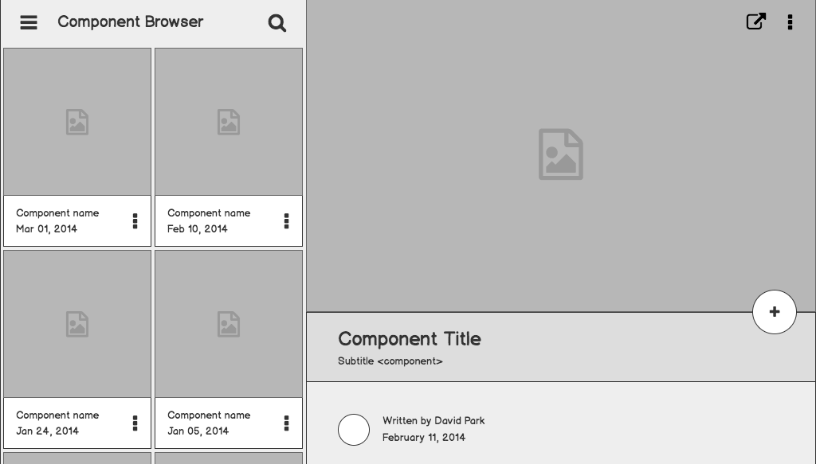

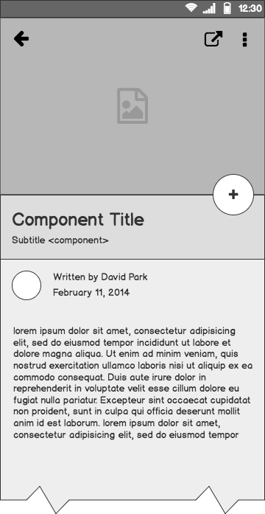
Quantum Machine Learning
An Introduction to Quantum - Powered AI

Slide 2

Presenter: Aakansha Vijay,
Apurva Kacholiya,
Gunjan Bhojwani,
Hargun Yashkumar Ashwinbhai,
Sachin Kukkar,
Twinkle Gupta
Institute: SKIT & PU, Jaipur, Rajasthan
Presented to: Dr. Prashant Verma
Date: 09 June 2025

Slide 3

TOPICS
What is Quantum Machine Learning?
Quantum Computing Fundamentals
Classical Machine Learning Primer
Why combine Quantum and ML
Quantum Data Encoding
QUantum Kernels
Variational Quantum Circuits
Quantum Neural Networks
Key QML Algorithms
Challenges in QML
QML libraries and Tools
QML Applications
Case Study : QSVM on Iris Dataset
Future of QML
References
Q&A

Slide 4
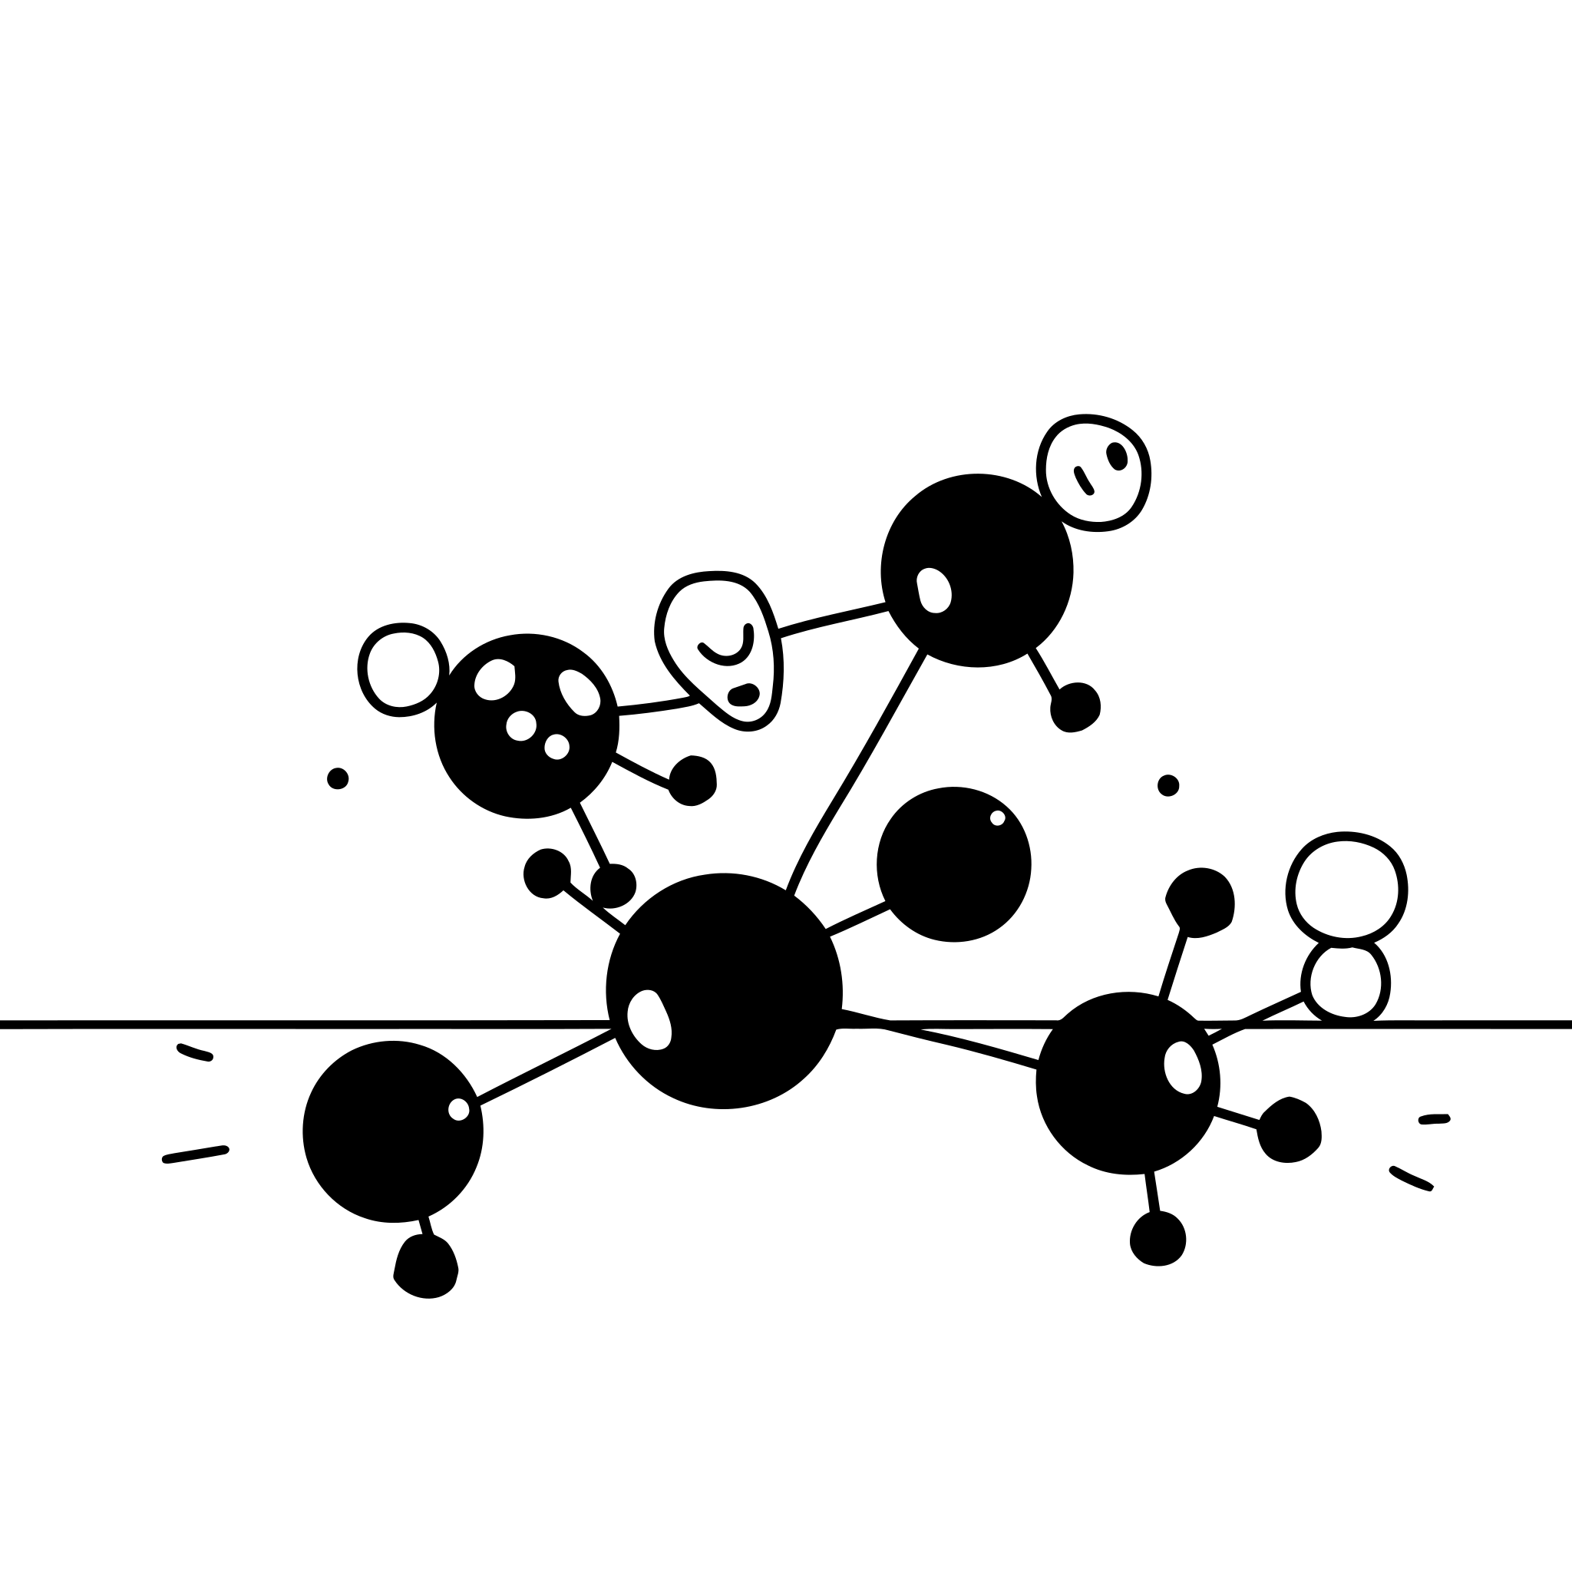
What is Quantum Machine Learning?

Slide 5
Setting the Stage: The AI Revolution
The 21st century has been significantly shaped by Artificial Intelligence (AI) and Machine Learning (ML), driving advancements in every sector from healthcare to finance.
We've seen unprecedented capabilities in areas like image recognition, natural language processing, and complex decision-making systems.
However, as data scales and problems become more intricate, classical computing models face fundamental limits in processing power, memory, and energy efficiency.
This increasing demand for more powerful, efficient, and sophisticated AI necessitates exploring new computational paradigms.

Slide 6
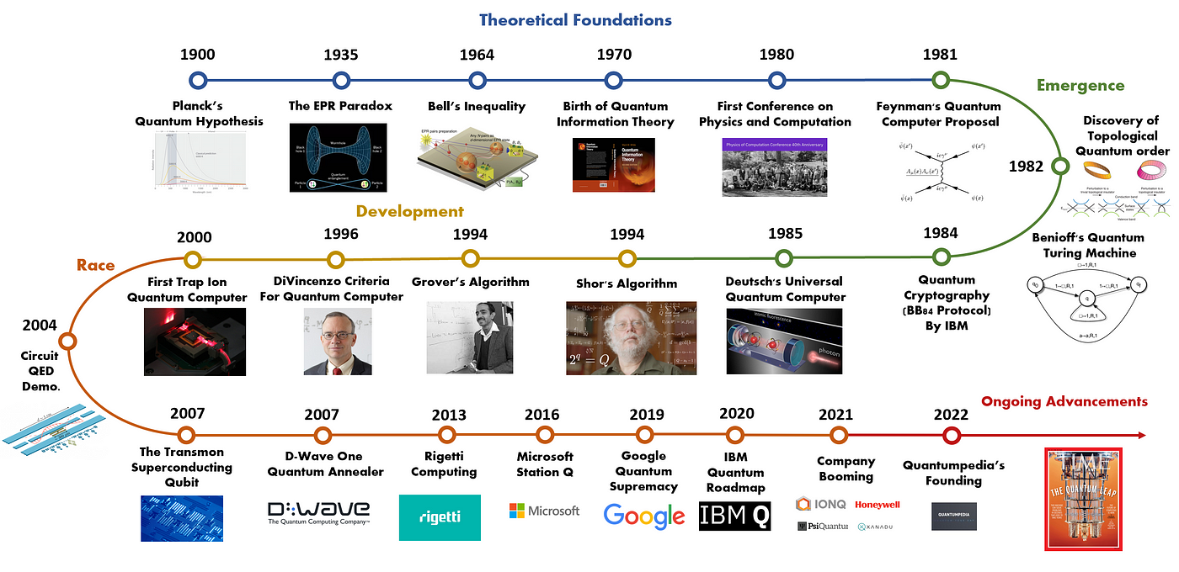

Slide 7
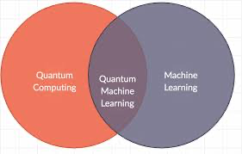
Defining Quantum Machine Learning (QML)
QML is an interdisciplinary field that merges quantum computing principles with classical machine learning algorithms.
It explores how quantum phenomena (superposition, entanglement, interference) can be leveraged to enhance ML tasks.
Not just classical ML on quantum computers, but ML inspired by or enhanced by quantum mechanics.

Slide 8
Why Quantum Machine Learning (QML)?
The Motivation
Overcoming Classical Limitations: Addressing challenges where classical algorithms struggle (e.g., large datasets, high-dimensional feature spaces, complex optimization problems).
Exploiting Quantum Properties: Using superposition for massive parallel computation and entanglement for capturing complex data correlations.
Potential for Speedups: Algorithmic advantages for specific subroutines (e.g., linear algebra, optimization).
Enhanced Data Representation: Quantum states can represent exponentially more information than classical bits, leading to richer data encoding.

Slide 9
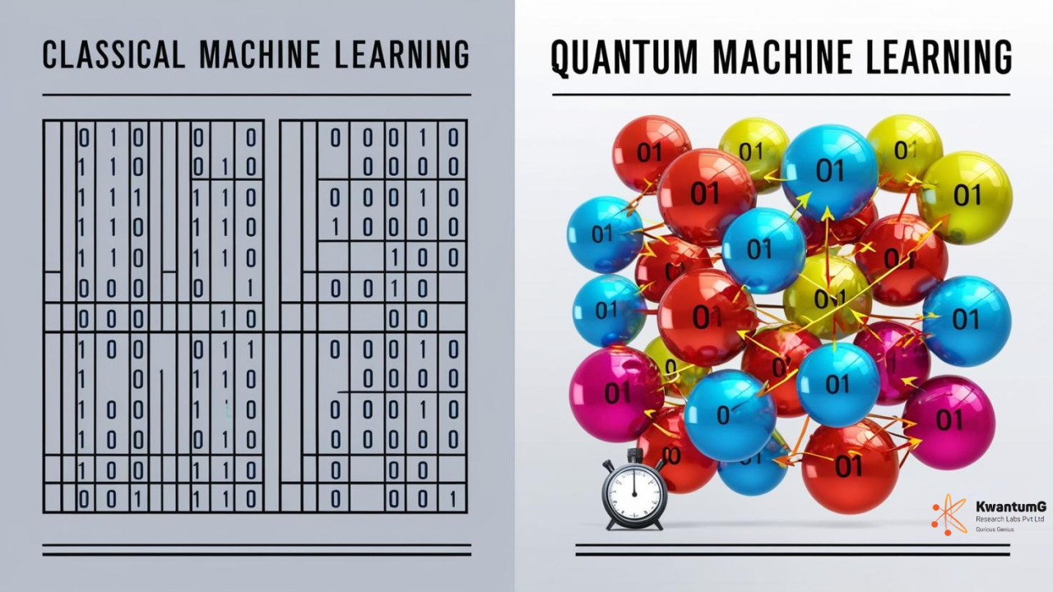
QML vs Classical ML: A Conceptual Pipeline Comparison

Slide 10
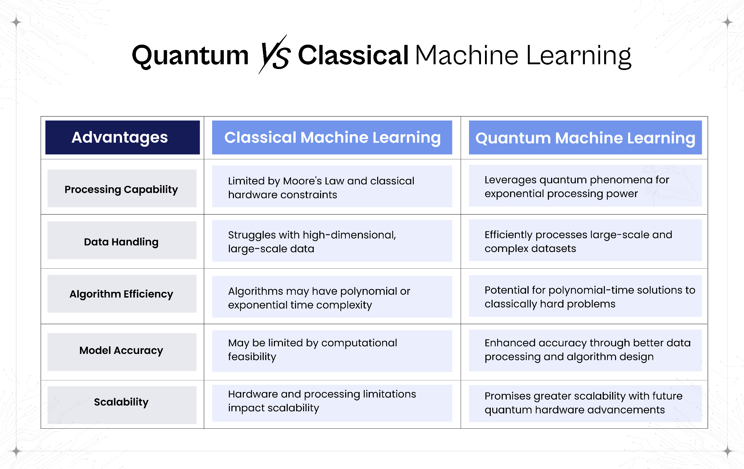

Slide 11
Quantum Computing Fundamentals

Slide 12
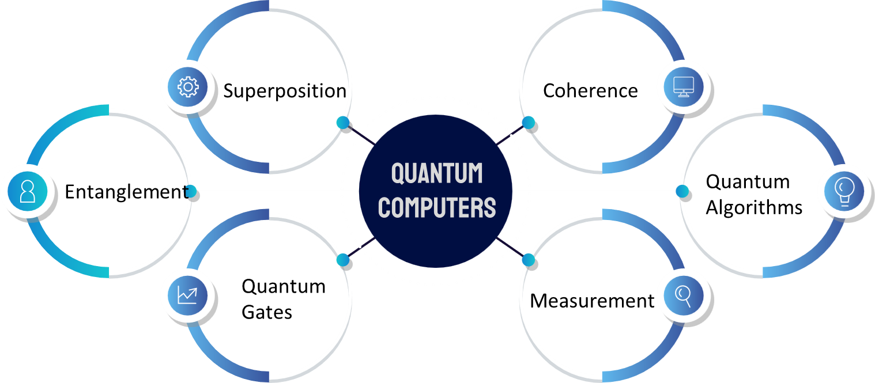
A Glimpse into Quantum Mechanics for Computing
Quantum computing is not just faster classical computing; it leverages the strange and counter-intuitive laws of quantum mechanics to perform calculations.
At the subatomic level, particles behave differently than macroscopic objects. They can exist in multiple places at once, be instantaneously linked, and their properties are probabilistic until measured.
These principles – superposition, entanglement, and interference – are the bedrock upon which quantum computers are built, enabling them to solve problems classically intractable.
Understanding these fundamental concepts is crucial for appreciating how QML operates.

Slide 13
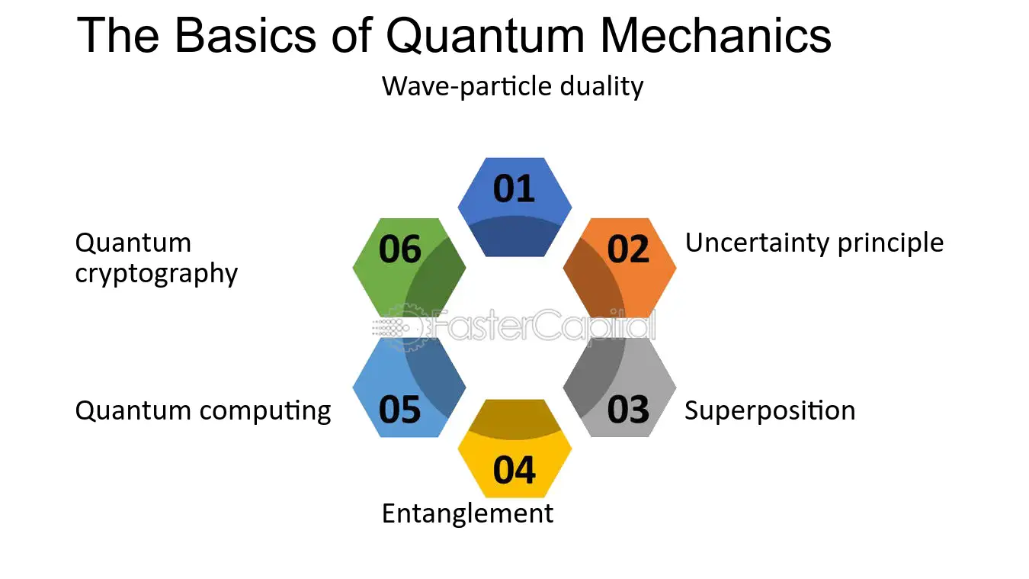

Slide 14
Qubits: The Basic Unit of Quantum Information
Definition: It is the fundamental building block of quantum information, analogous to a classical bit.
Classical Bit: Can only exist in one of two definite states: 0 or 1. (Think of a light switch: either ON or OFF).
Qubit: Can be 0, 1, or a superposition of both simultaneously. This means it can exist in a linear combination of ∣0⟩ and ∣1⟩.
The state of a qubit is described by a complex probability amplitude for each basis state. When measured, the qubit collapses to either 0 or 1 with a certain probability.
This ability to hold multiple states at once is a cornerstone of quantum parallelism.

Slide 15
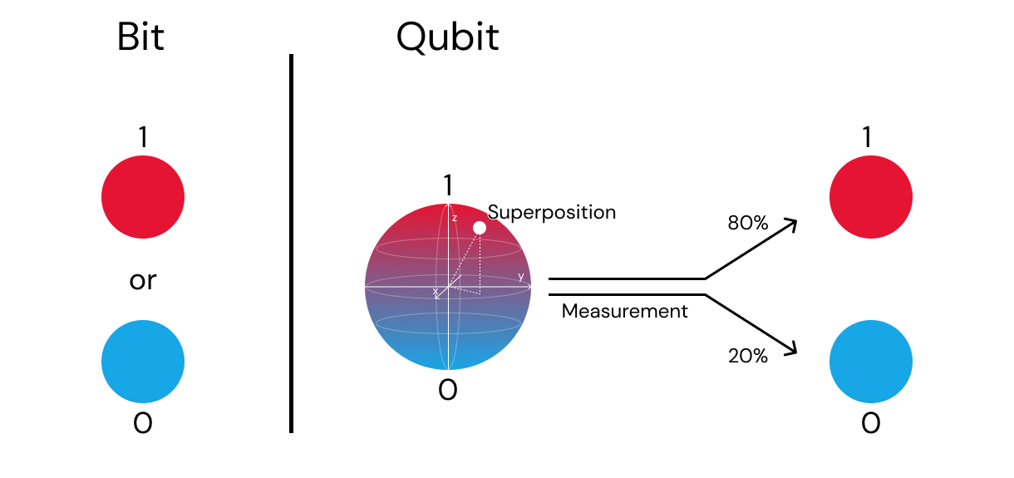
Qubit vs Classical Bit

Slide 16
Superposition: The Power of Being Everywhere at Once
Elaboration: A qubit in superposition doesn't just represent 0 or 1; it represents a probabilistic combination of all possible states simultaneously.
Mathematically, a qubit state is often written as: ∣ψ⟩=α∣0⟩+β∣1⟩, where α and β are complex amplitudes, and the sum of their squared magnitudes (∣α∣2+∣β∣2) must equal 1 (representing the total probability).
This means a quantum computer with n qubits in superposition can effectively process 2n possibilities in parallel. This exponential increase in computational space is a key source of quantum advantage.
Upon measurement, this superposition collapses to a single definite classical state (0 or 1) based on the probabilities determined by α and β.

Slide 17
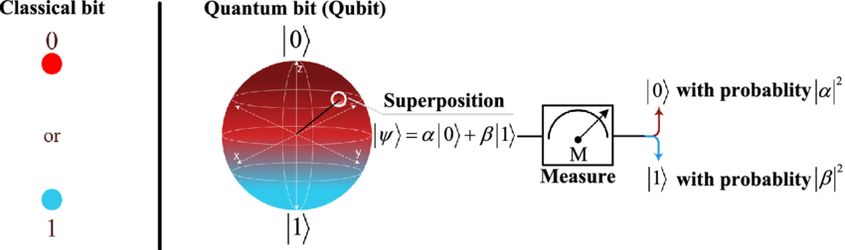
Superposition in Qubit

Slide 18
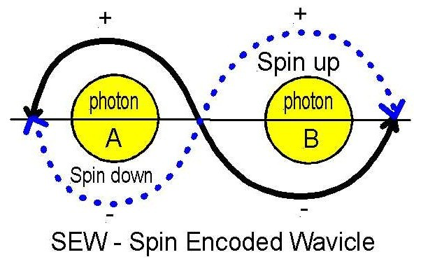
Entanglement: Spooky Action at a Distance
Definition: Entanglement is a profound quantum phenomenon where two or more qubits become inextricably linked, forming a single, shared quantum state.
When qubits are entangled, the state of one qubit instantaneously influences the state of the others, regardless of the physical distance between them.
This "spooky action at a distance" (Einstein's term) creates non-classical correlations that are far stronger than any classical correlation.
Example: If two qubits are entangled such that they are always in the same state (both 0 or both 1), and you measure one to be 0, you instantly know the other is also 0, without ever measuring it.

Slide 19
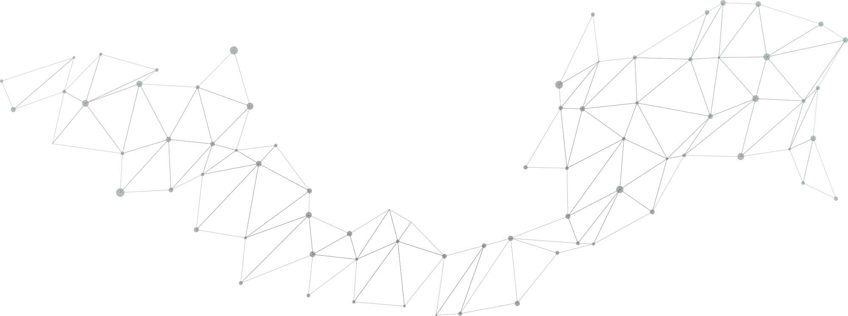
The Bloch Sphere: Visualizing a Single Qubit
Purpose: The Bloch Sphere is a geometric representation of the pure state space of a single qubit. It provides an intuitive way to visualize a qubit's state and how quantum operations transform it.
Any point on the surface of the sphere represents a valid pure state of a single qubit, including superpositions.
The poles of the sphere represent the basis states: the North Pole is ∣0⟩ and the South Pole is ∣1⟩.
Rotations on the Bloch Sphere correspond to applying quantum gates. For example, a Hadamard gate rotates ∣0⟩ to a superposition state on the equator.

Slide 20
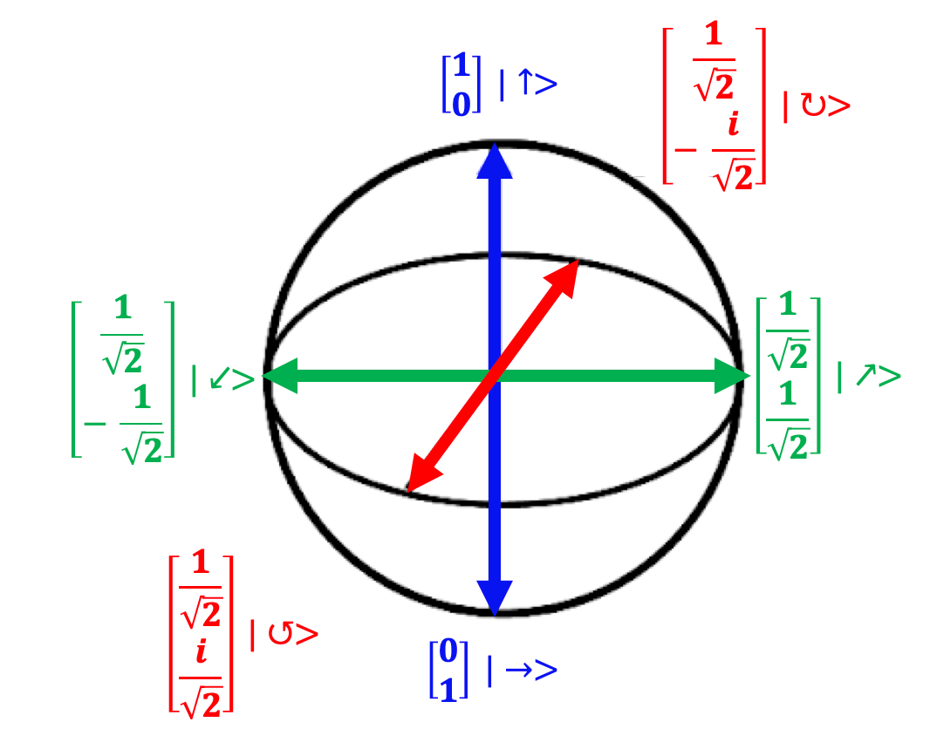
Bloch Sphere

Slide 21
Quantum Gates: The Building Blocks of Circuits
A quantum gate is a very simple computing device that performs quantum operation on qubits. Quantum gates are one of the essential parts of a quantum computer and are the building blocks of all quantum algorithms.
Quantum gates are mathematically represented as transformation matrices which operate on inputs to give outputs.
Two types:
Single Qubit Gates
Multiple Qubit Gates

Slide 22
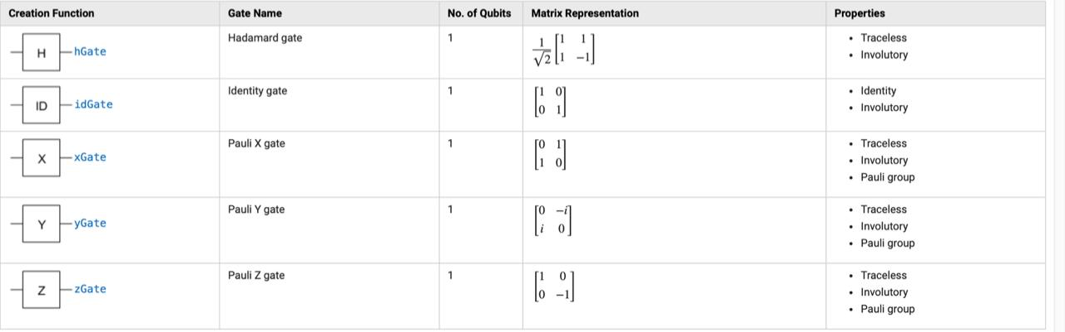
Basic Quantum Gates

Slide 23
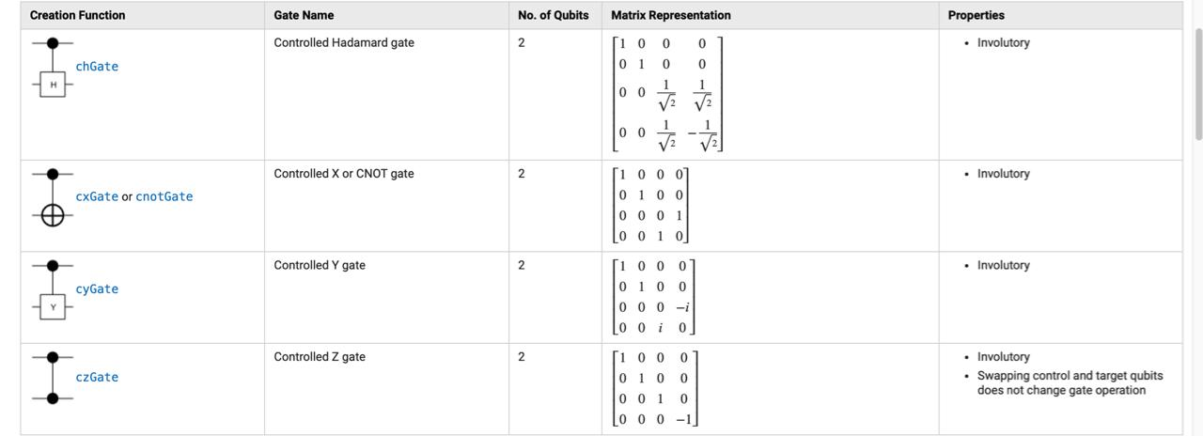

Slide 24
Classical Machine Learning Primer

Slide 25
Introduction to Classical Machine Learning
Machine Learning (ML) is a subset of AI that focuses on enabling computer systems to "learn" from data without being explicitly programmed for every task.
Instead of hard-coded rules, ML algorithms build models based on example data, allowing them to make predictions or decisions.
ML has transformed countless industries and daily lives, powering everything from personalized recommendations to medical diagnostics and autonomous vehicles.
It typically involves identifying patterns, making predictions, or taking actions based on insights derived from vast amounts of data.

Slide 26
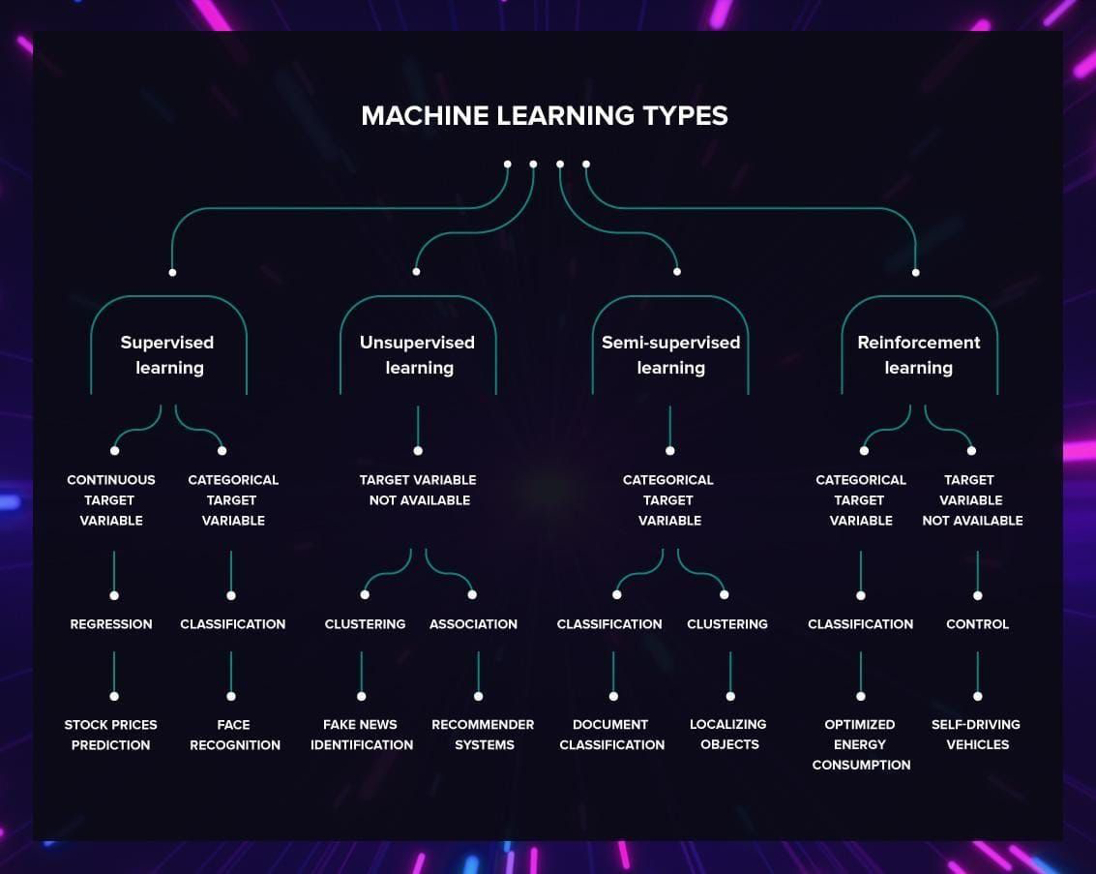

Slide 27
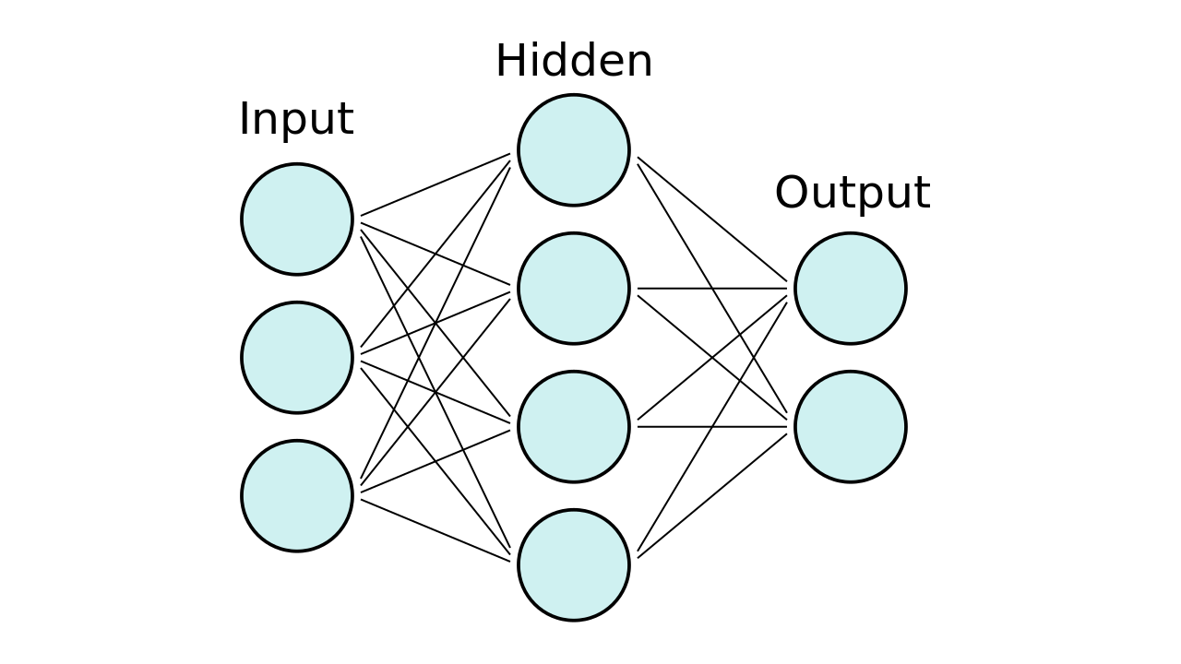
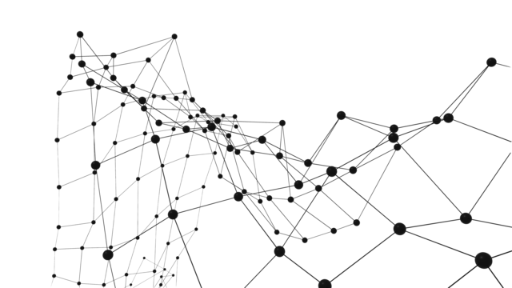
Neural Networks: The Powerhouse of Deep Learning
Structure: Input layer, hidden layers, output layer.
Neurons: Basic units performing computations (weighted sum + activation function).
Deep Learning: NNs with multiple hidden layers, capable of learning hierarchical features.
Applications: Image recognition, natural language processing, speech recognition.

Slide 28
Training ML Models: Cost Functions and Optimization
Cost Function (Loss Function):
A mathematical function that quantifies the "error" or "cost" of a model's predictions compared to the actual target values.
The goal of training an ML model is to minimize this cost function. A lower cost indicates a better-performing model.
Examples: Mean Squared Error (for regression), Cross-Entropy Loss (for classification).
Optimization:
The iterative process of adjusting the model's internal parameters (e.g., weights and biases in a neural network) to minimize the cost function.
This involves finding the optimal set of parameters that make the model's predictions as close as possible to the true values.

Slide 29
Why Combine Quantum and ML?

Slide 30
The Rationale for a Quantum-Classical Symbiosis
NISQ Limitations: Current quantum devices are noisy, have few qubits, and short coherence times.
Purely Quantum ≠ Practical: Deep or large-scale quantum algorithms are not yet feasible.
Hybrid Advantage:
Classical: Handles control logic, data processing, optimization.
Quantum: Performs high-dimensional mapping and complex subroutines efficiently.
Bridge Strategy: Hybrid QML lets us explore quantum benefits today while hardware improves.

Slide 31
Hybrid Classical-Quantum Algorithms: The Feedback Loop
Core Idea: A classical optimizer iteratively tunes a parameterized quantum circuit.
Steps:
Initialize quantum circuit parameters (classical)
Execute quantum circuit (quantum) Measure output, compute cost (classical)
Update parameters to minimize loss (classical)
Repeat until convergence
Examples: VQE, QAOA, VQC — hybrid algorithms demonstrating this loop

Slide 32
Potential Advantages: Speed-ups in Linear Algebra Subroutines
Speed-ups in Linear Algebra Subroutines
Many ML algorithms heavily rely on linear algebra (e.g., matrix inversion, eigenvalue decomposition, solving linear equations).
Quantum algorithms like HHL (Harrow, Hassidim, Lloyd) algorithm can solve linear equations exponentially faster than classical counterparts for certain sparse matrices.
Enhanced Expressivity and Parameter Efficiency
Expressivity: Quantum circuits can explore a much larger Hilbert space than classical models with a comparable number of parameters, allowing for more complex data correlations to be captured.
Parameter Efficiency: Potentially, a quantum model might achieve similar performance to a classical model with significantly fewer trainable parameters, making it more efficient for certain tasks.

Slide 33
Quantum Data Encoding

Slide 34
The Crucial Step: Quantum Data Encoding
The Bridge: Classical data, which is typically stored as binary bits, cannot be directly fed into a quantum computer. It must first be translated or "encoded" into a quantum state.
Challenge:. It transforms classical information into quantum information, represented by the amplitudes or phases of qubits.
Impact on Performance: The choice of encoding method is paramount. It directly influences:
The number of qubits required.
The complexity of the quantum circuit needed to prepare the state.
The overall performance and expressivity of the QML algorithm.
The potential for achieving a quantum advantage.

Slide 35
Basis Encoding (Computational Basis Encoding)
Method: Represents classical binary data directly into the computational basis states of qubits. Each classical bit corresponds to one qubit.
Example: Classical binary 101 becomes |101> .
Pros: Simple, intuitive, requires a number of qubits equal to the number of classical bits.
Cons: Does not fully utilize quantum properties like superposition or entanglement for data representation itself. Can be qubit-intensive for large classical inputs.

Slide 36
Amplitude Encoding
Method: Encodes classical real numbers into the amplitudes of an n-qubit quantum state.
Example: To encode 4 classical values, you need only 2 qubits.
Pros: Exponential compression of data (N qubits can represent 2N values), utilizes superposition effectively. Highly efficient for high-dimensional vectors.
Cons: Difficult to prepare arbitrary amplitude states on current hardware; requires complex quantum circuits for arbitrary data. Can be lossy if not all information is retained.

Slide 37
Angle Encoding (Parameter Encoding / Feature Mapping)
Method: Encodes classical data points by rotating qubits by angles proportional to the data values.
Example: A classical feature might be encoded by applying a Ry​(x) or Rz​(x) gate to a qubit.
Pros: Flexible, allows for non-linear feature maps, commonly used in Variational Quantum Classifiers (VQC) as it generates quantum feature spaces.
Cons: Can be challenging to design optimal feature maps that lead to quantum advantage; the mapping might not always be easy to visualize.

Slide 38
Quantum Kernels

Slide 39
What are Quantum Kernels?
A Quantum Kernel uses a Quantum Computer to calculate the similarity between data points after encoding them into quantum states.
Quantum kernels form a foundational component of quantum-enhanced machine learning algorithms, particularly in classification problems. Leveraging quantum mechanical principles, these kernels enable efficient similarity computation in high-dimensional Hilbert spaces, potentially offering computational advantages over classical counterparts.

Slide 40
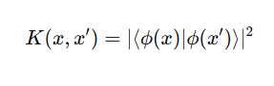
Inner Product of Quantum States
Mathematically: Let ϕ be a feature map over the input Ω, encoding our data into quantum information. A quantum kernel is a kernel given by the inner product (in Dirac notation), defined on our space of quantum states, between two quantum states:
This represents the squared fidelity or overlap between the two quantum states and quantifies their similarity in the quantum feature space.

Slide 41
QSVM idea:
Compute kernel via quantum circuits
The Quantum Support Vector Machine (QSVM) algorithm incorporates quantum kernels into the classical SVM framework.
The quantum computer is tasked with evaluating the kernel matrix K, where each element is computed via quantum circuits that measure the inner products of data-encoded quantum states.
The classification boundary is then determined through a classical SVM solver using the quantum kernel matrix.

Slide 42
Use in classification Problems
Quantum kernels have been applied to supervised learning tasks, especially binary classification, where the structure of the data may be non-linearly separable in classical space.
By mapping data into a quantum Hilbert space, QSVM can discover decision boundaries that are otherwise difficult to achieve with standard kernels.
Experimental implementations on NISQ devices have demonstrated promise in domains such as finance, material science, and biology.

Slide 43
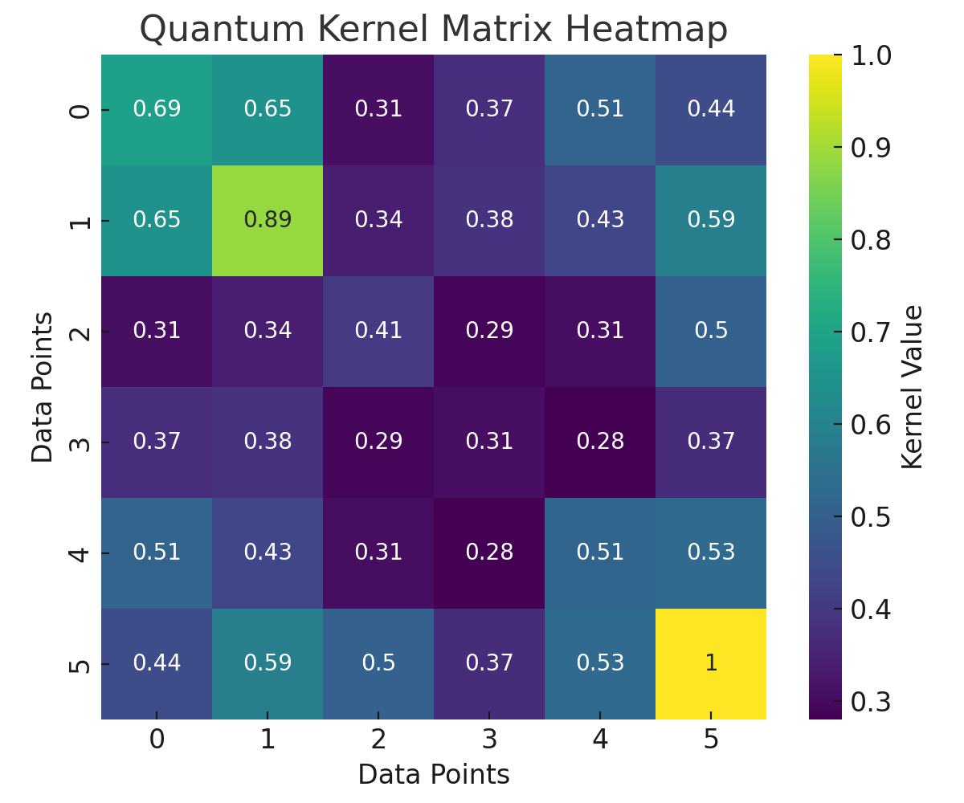
Visual: kernel matrix heatmap

Slide 44
Variational Quantum Circuits
(VQC)

Slide 45
What are Variational Quantum Circuits?
Variational Quantum Circuits (VQCs) are hybrid quantum-classical models at the heart of variational algorithms such as the Variational Quantum Eigensolver (VQE) and Quantum Neural Networks (QNNs).
These circuits are composed of parameterized quantum gates whose parameters are optimized through a classical feedback loop.

Slide 46
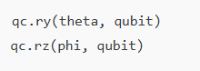
Parametrized gates: Ry(theta), Rz(phi)
Ry(θ): Rotation around the Y-axis by angle θ
Rz(φ): Rotation around the Z-axis by angle φ
They can be applied as:

Slide 47
Optimization Loop
Initialize parameters θ, φ randomly.
Construct the quantum circuit with these parameters.
Run the circuit on a simulator or real device to get measurement results.
Calculate a cost function from the results.
Use a classical optimizer (e.g., COBYLA, SPSA, Adam) to update parameters to minimize the cost.
Repeat until convergence.

Slide 48
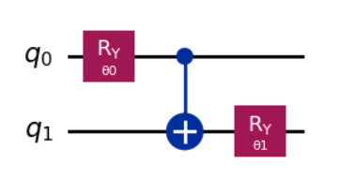
from qiskit import QuantumCircuit
from qiskit.circuit import Parameter
theta = [Parameter('θ0'), Parameter('θ1')]
# Create variational quantum circuit
qc = QuantumCircuit(2)
qc.ry(theta[0], 0)
qc.cx(0, 1)
qc.ry(theta[1], 1)
qc.draw('mpl')
Output:

Slide 49
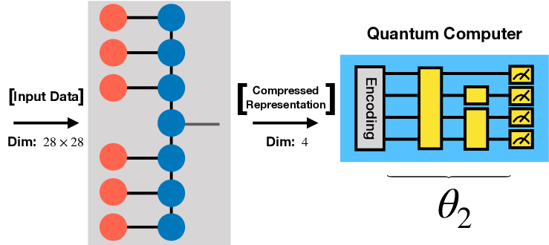
VQC Architecture
Hybrid TN-VQC Architecture. The tunable parameters labeled with θ 1 and θ 2 are the parameters for the MPS and VQC respectively.

Slide 50
Quantum Neural Networks

Slide 51
What is Quantum Neural Networks?
Quantum Neural Networks (QNNs) represent a groundbreaking convergence of quantum computing and artificial intelligence.
They promise to revolutionize machine learning by harnessing the unique properties of quantum mechanics.
Following slides explores the core concepts, challenges, and future potential of QNNs.

Slide 52
Layered Parameterized Quantum Circuits (PQCs)
A Layered Parameterized Quantum Circuit (PQC) is a quantum circuit made up of gates that have tunable (trainable) parameters, arranged in layers—similar to layers in a neural network

Slide 53
Explanation :
Parameterized Quantum Gates:
Some quantum gates, like rotation gates (e.g., Ry(θ), Rz(ϕ)), can take real-valued parameters.
These parameters are like the weights in classical machine learning models.
Layered Architecture:
PQCs are built in repeated layers:
Each layer has rotation gates to modify individual qubits.
Followed by entangling gates (like CNOT) to create interaction between qubits.
Training the Circuit:
The parameters are adjusted using classical optimization algorithms (e.g., gradient descent).
The goal is to minimize a cost function based on the quantum circuit’s output.
Use in Quantum Neural Networks (QNNs):
PQCs form the core of QNNs — they process input quantum data and are trained to solve problems like classification or pattern recognition.

Slide 54
Quantum Perceptron Analogy
The Quantum Perceptron is the quantum counterpart of the classical perceptron, used in neural networks. Instead of using real-valued inputs and weights, it uses qubits and parameterized quantum gates.
Inputs are encoded as quantum states.
Parameterized gates (like Ry(θ)) play the role of adjustable weights.
Entanglement allows complex interactions between qubits.
Measurement gives a binary output (0 or 1), like an activation function.

Slide 55
Challenge – Barren Plateaus
Barren plateaus are a major challenge in training quantum neural networks.
They occur when the gradient of the cost function becomes extremely small as the number of qubits or circuit depth increases.
This makes it very hard for optimizers to learn, since parameter updates become ineffective.
It’s similar to getting stuck in a flat region of a loss landscape in classical deep learning.
More common in deep or random quantum circuits.
Solutions include using shallower circuits, smart initialization, or layer-wise training.
In short: barren plateaus slow down or stop learning in quantum machine learning models.

Slide 56
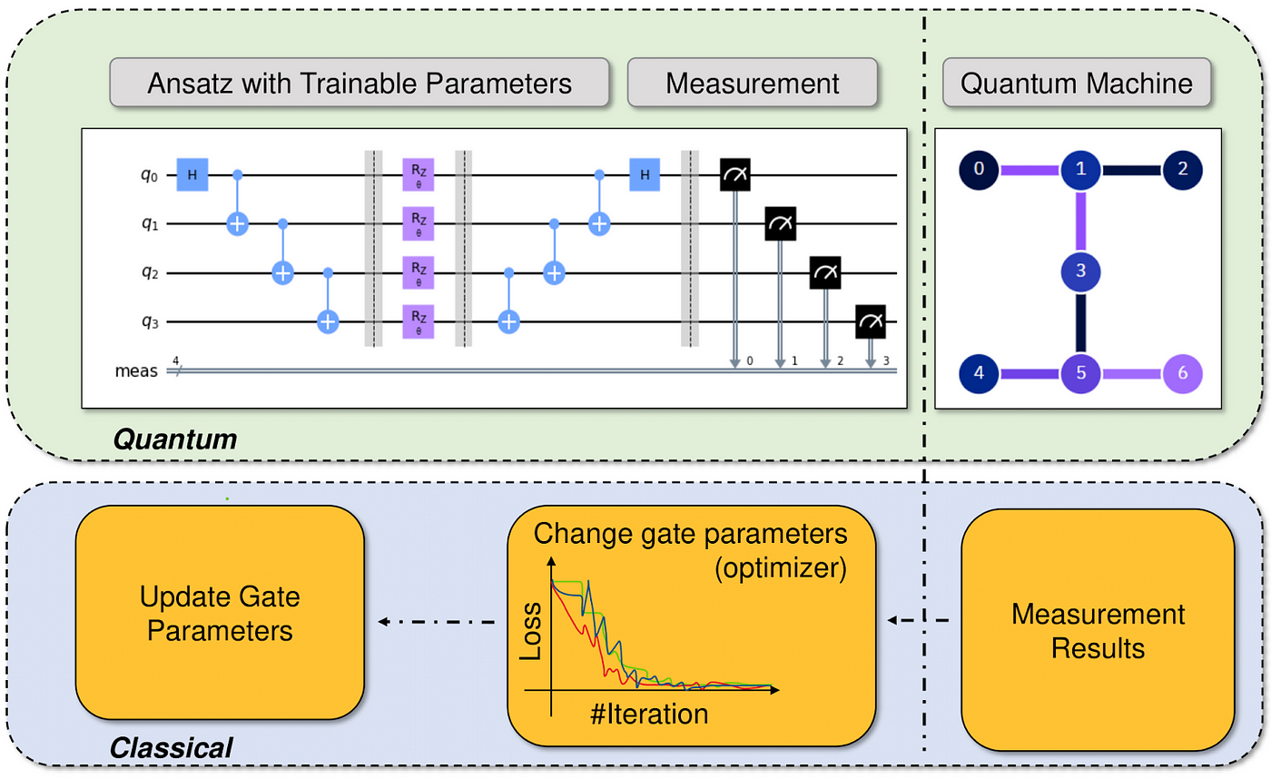
Visual: VQC with multiple layers

Slide 57
Key QML Algorithms

Slide 58
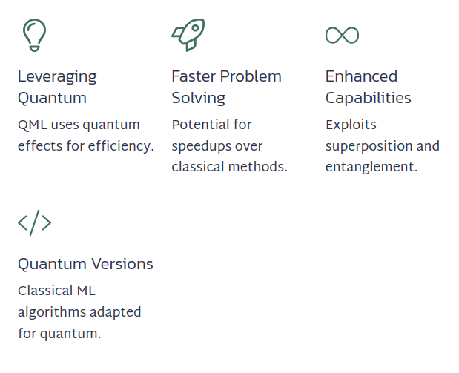
What is QML
Algorithm?

Slide 59
QSVM – Quantum Support Vector Machine
QSVM applies quantum computing principles to enhance classical SVM algorithms, particularly for classification tasks.
Quantum Kernel Estimation:
QSVM leverages quantum states to compute kernel functions efficiently.
Uses quantum computers to perform feature space transformations, enabling better separation of non-linear data.
Advantages:
Offers exponential speed-up in calculating kernel matrices.
Handles high-dimensional data transformations efficiently.
Applications:
Image recognition, bioinformatics, and financial modeling.

Slide 60
QSVM – Quantum Support Vector Machine
Steps in QSVM Implementation:
Data Encoding: Map classical data into quantum states.
Quantum Kernel Calculation: Use quantum circuits to compute inner products of quantum states.
Classification: Train the SVM using quantum-enhanced kernel values.
Prediction: Apply the model to classify unseen data.

Slide 61
QkNN – Quantum k-Nearest Neighbors
QkNN enhances the classical kNN algorithm by exploiting quantum mechanics for faster distance computations and improved nearest-neighbor searches.
Features and Principles:
Quantum Distance Calculation:
Uses quantum algorithms like Grover's search for faster distance computations.
Reduces the time complexity of finding the nearest neighbors.
Quantum Parallelism:
Evaluates distances to multiple points simultaneously using quantum superposition.
Advantages:
Exponentially faster for large datasets.
Reduces computational bottlenecks in high-dimensional data spaces.

Slide 62
QkNN – Quantum k-Nearest Neighbors
Steps in QkNN Implementation:
Quantum Data Encoding: Encode data points as quantum states.
Distance Computation: Use quantum algorithms to calculate distances in parallel.
Neighbor Selection: Identify the k-nearest neighbors using quantum searches.
Class Prediction: Use majority voting among the neighbors for classification.

Slide 63
QPCA – Quantum Principal Component Analysis
QPCA is the quantum version of PCA, a dimensionality reduction technique that uses quantum algorithms for enhanced computational efficiency.
Quantum State Preparation: Encodes the covariance matrix as a quantum state.
Eigenvalue and Eigenvector Estimation: Uses quantum phase estimation to extract principal components.
Advantages:
Exponential speed-up for calculating eigenvalues and eigenvectors.
Handles large-scale data efficiently.
Steps in QPCA Implementation:
Data Preparation: Represent the data covariance matrix in a quantum state.
Quantum Phase Estimation: Compute eigenvalues and eigenvectors of the covariance matrix.
Dimensionality Reduction: Select top components based on eigenvalues.
Projection: Transform the original data into the reduced-dimensional space.

Slide 64
qGAN – Quantum Generative Adversarial Network
Quantum adaptation of GANs for generating data distributions and patterns.
Features and Principles:
Quantum Generator: Employs quantum circuits to create synthetic data. Utilizes quantum superposition and entanglement for complex distributions.
Quantum or Classical Discriminator: Compares generated data with real data to iteratively improve the generator.
Advantages:
Leverages quantum parallelism for efficient training.
Models high-dimensional and intricate data distributions.
Steps in qGAN Implementation:
Quantum Generator Design: Construct a quantum circuit encoding random quantum states.
Discriminator Setup: Use a classical or quantum discriminator to evaluate generated vs. real data.
Training: Alternate updates between generator and discriminator to minimize loss.
Data Generation: Generate new data samples using the trained quantum generator.

Slide 65
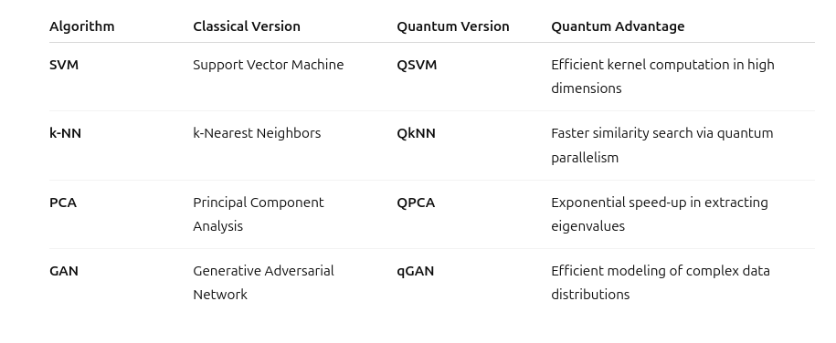
Table: Classical vs Quantum variants

Slide 66
Challenges in QML

Slide 67
Noisy Quantum Gates
What is it?
Quantum gates are not perfect on real hardware.
They introduce errors due to interaction with the environment (decoherence) and imperfect control.
Types of Quantum Noise:
Depolarizing Noise: Qubit randomly loses its state with some probability.
Dephasing Noise: Loss of quantum phase information.
Amplitude Damping: Qubit tends to relax from |1⟩ to |0⟩ state.
Gate Errors: Inaccuracies in applying unitary operations.
Impact on QML:
Degrades the quality of learning.
Affects repeatability and accuracy of measurement outcomes.
Makes training unstable or ineffective.

Slide 68
Barren Plateaus
Definition:
A phenomenon where the cost function gradients approach zero, making it difficult to optimize quantum circuits.
Causes:
Random Initialization: Parameters initialized with near-zero expected gradients.
Circuit Complexity: Deep circuits lead to exponentially vanishing gradients.
Global Cost Functions: Cost functions based on global quantum state properties are more prone to barren plateaus.
Effects:
Slows training progress.
Makes optimization computationally infeasible for large systems.
Mitigation Strategies:
Localized Cost Functions: Focus on local properties of the system.
Layerwise Training: Optimize a few layers at a time.
Parameter Initialization: Start with parameters that avoid flat regions.

Slide 69
Data Encoding Bottleneck
Definition:
Occurs when encoding classical data into quantum states becomes inefficient or limits the quantum model's capacity.
Causes:
High Dimensionality: Encoding large datasets requires many qubits.
Complex Encoding: Deep circuits introduce noise and errors.
Limited Circuit Depth: Shallow circuits fail to capture complex data patterns.
Effects:
Reduces quantum model expressivity.
Limits the effectiveness of quantum machine learning.
Mitigation Strategies:
Efficient Encoding: Use hybrid methods like feature map optimization.
Dimension Reduction: Preprocess with techniques like PCA before quantum encoding.
Data Reuse: Recycle encoded states for multiple computations.

Slide 70
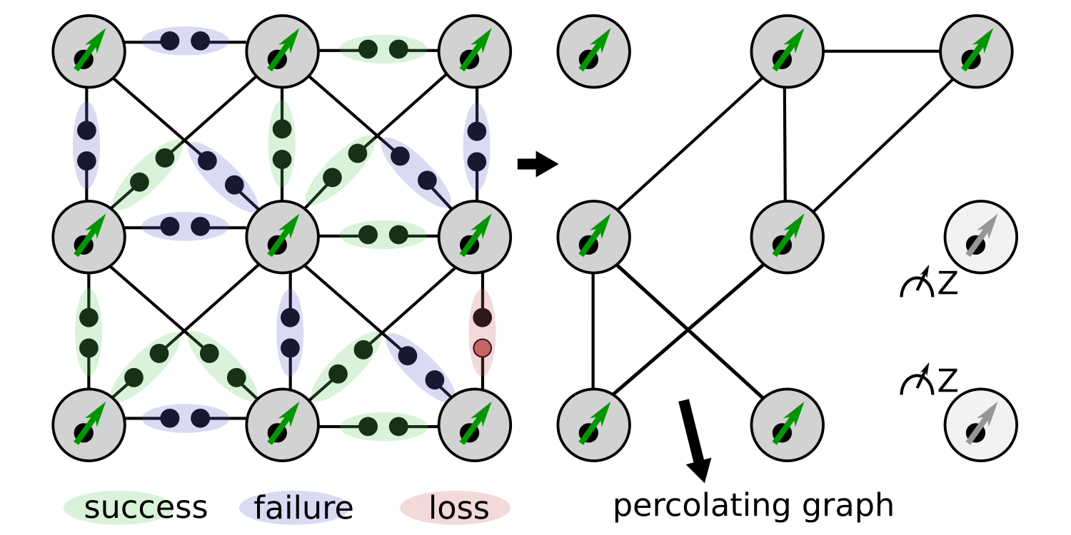
Loss surface comparison:

Slide 71
QML Libraries and Tools

Slide 72
1. 2.
Prominent QML Libraries in 2025 Understanding the Ecosystem Map
Key players in QML include Qiskit ML, PennyLane, An ecosystem map will illustrate the interconnections
TensorFlow, Quantum+, Amazon Braket ML and between various libraries and their hardware support,
QMLTorch. Showcasing the collaborative landscape of QML tools.
Each offers unique features for quantum data
processing

Slide 73
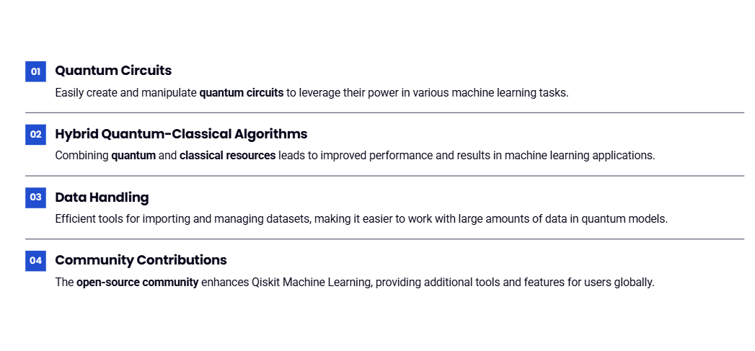
Exploring Key Features of Qiskit

Slide 74
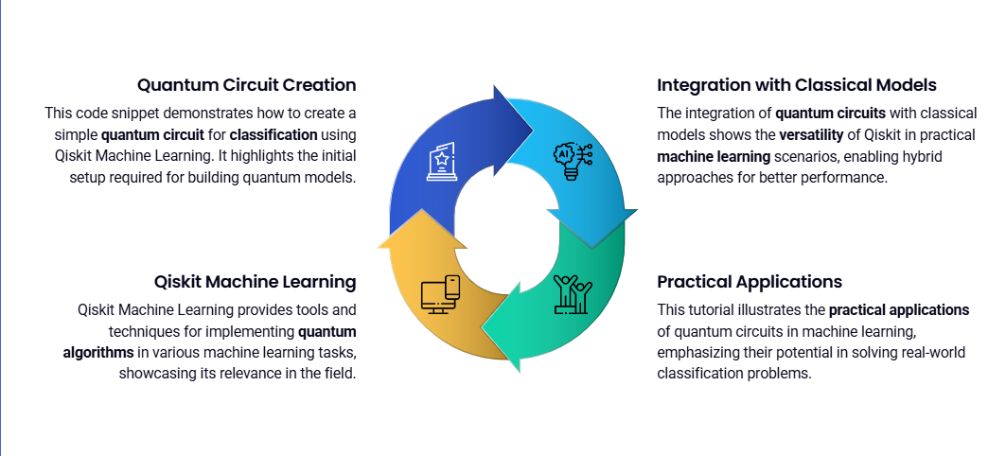
Quantum Circuit for Classification
using qiskit for machine learning applications

Slide 75
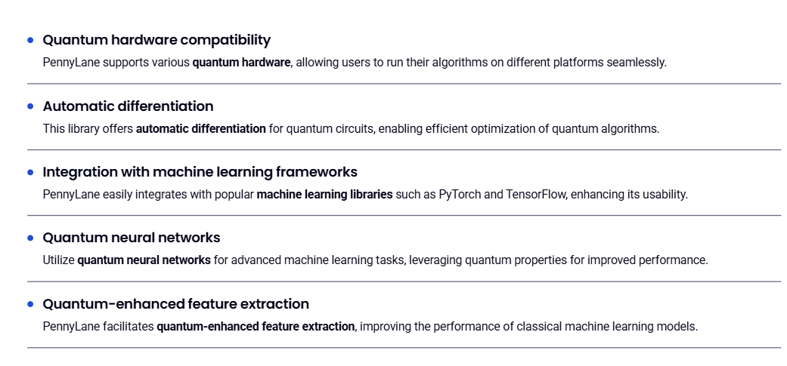
PennyLane Overview

Slide 76
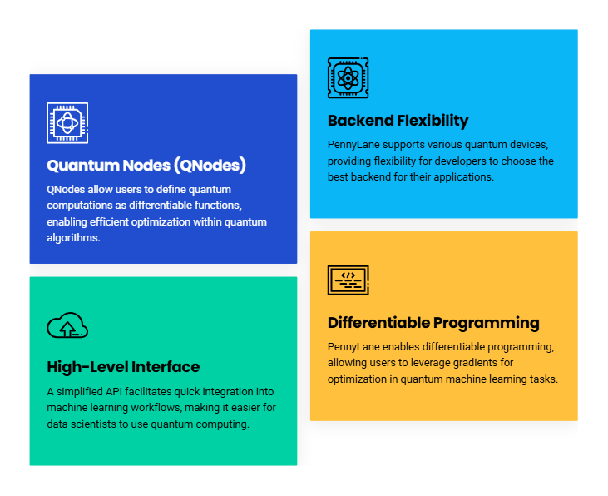
PennyLane : Core
Functionalities
Overview
Discover the essential features of
PennyLane that enhance quantum
computing and machine learning
integration

Slide 77
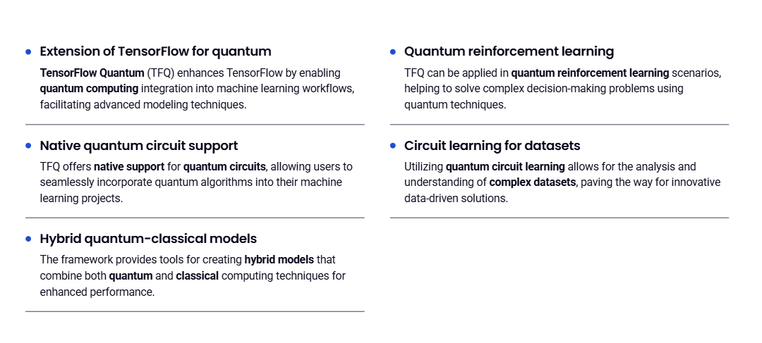
TensorFlow Quantum Overview

Slide 78
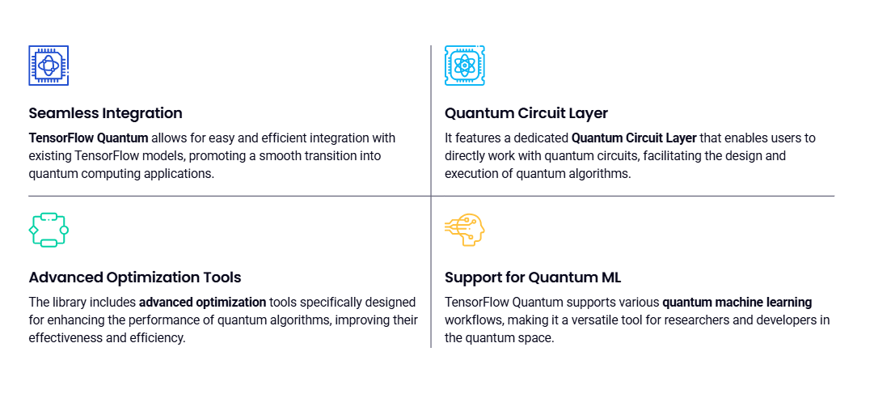
Exploring Key Features of TensorFlow Quantum

Slide 79
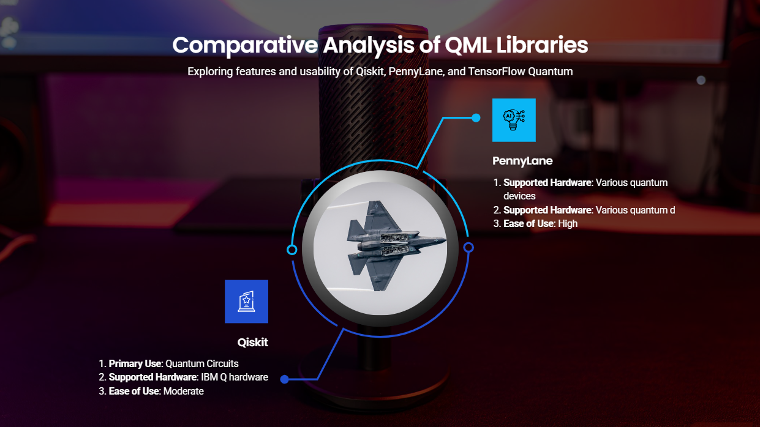

Slide 80
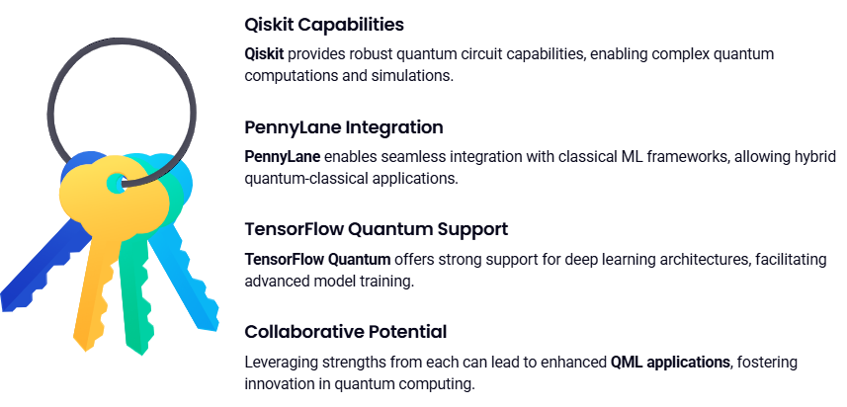
Synergies of Quantum Machine Learning Libraries

Slide 81
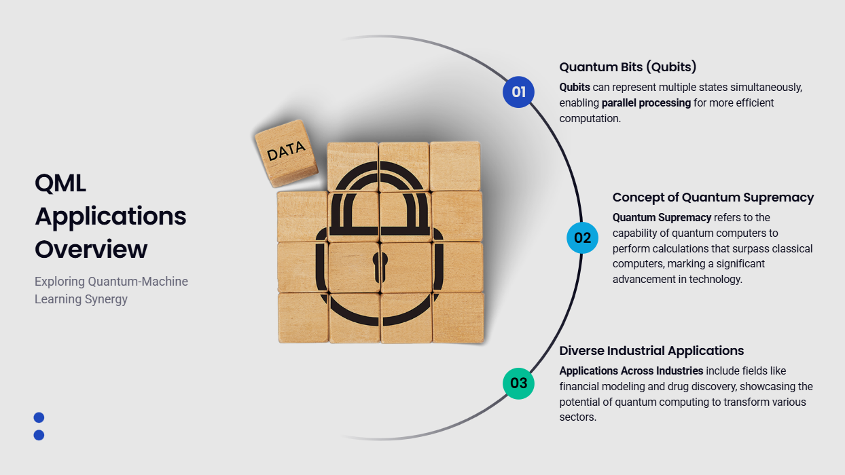

Slide 82
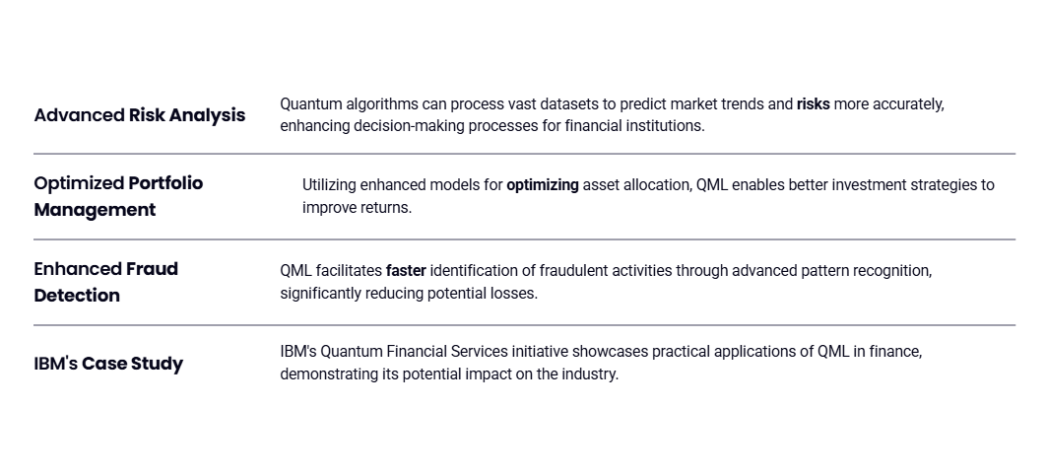
Quantum Finance Innovations
Transforming Financial Services with QML

Slide 83
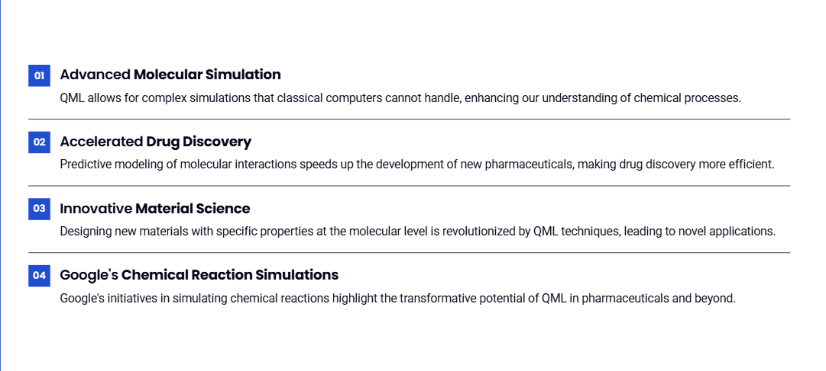
Quantum-Level Chemistry Innovations

Slide 84
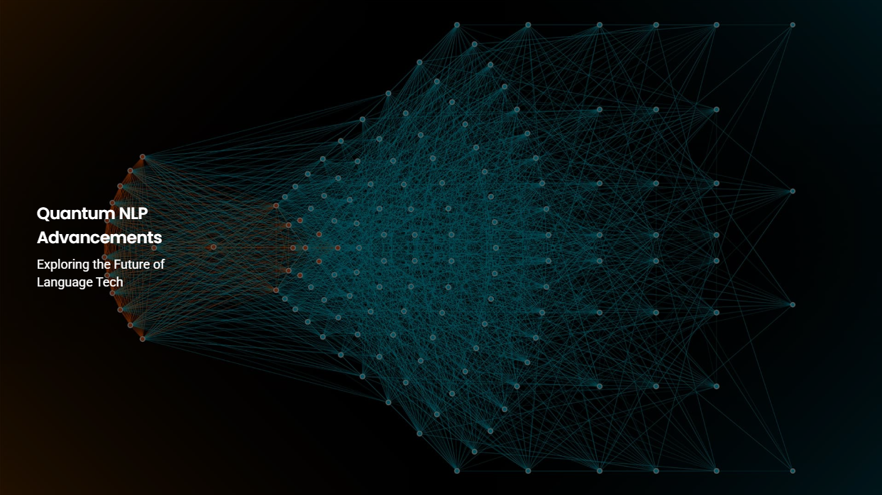
Enhanced Data Processing
Quantum Algorithms can analyze and interpret vast amounts of textual data, enabling faster and more comprehensive insights.
Improved Language Models
Higher accuracy in language understanding and generation leads to more effective communication between humans and machines.
Case Studies in Action
Companies are testing quantum-enhanced chatbots and translation services, showcasing real-world applications of quantum NLP.
Future Implications
Quantum NLP could lead to breakthrough in human-computer interaction, transforming how we engage with technology.

Slide 85
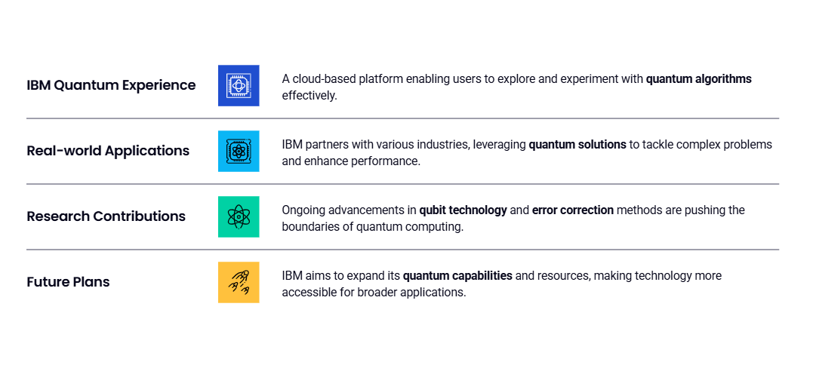
IBM’s Quantum Computing Innovations

Slide 86
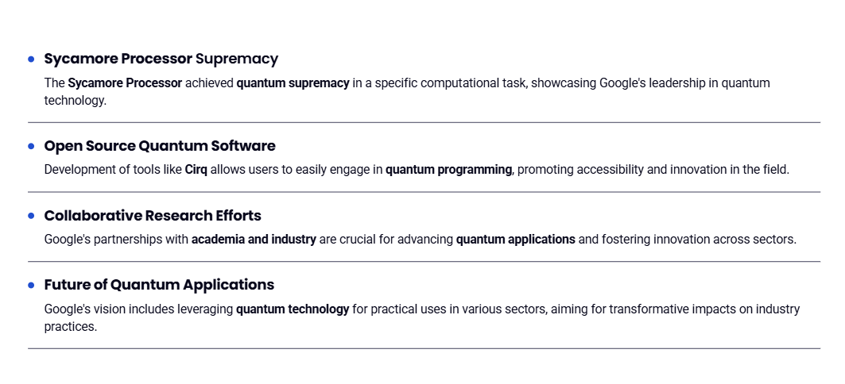
Google Quantum AI Innovations

Slide 87
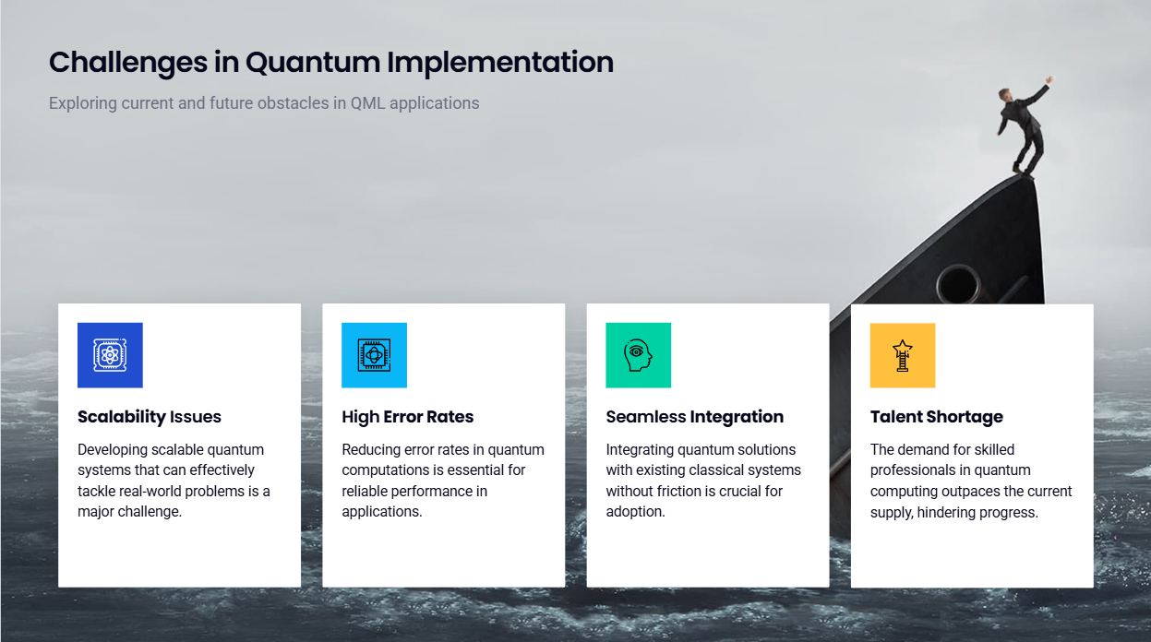

Slide 88
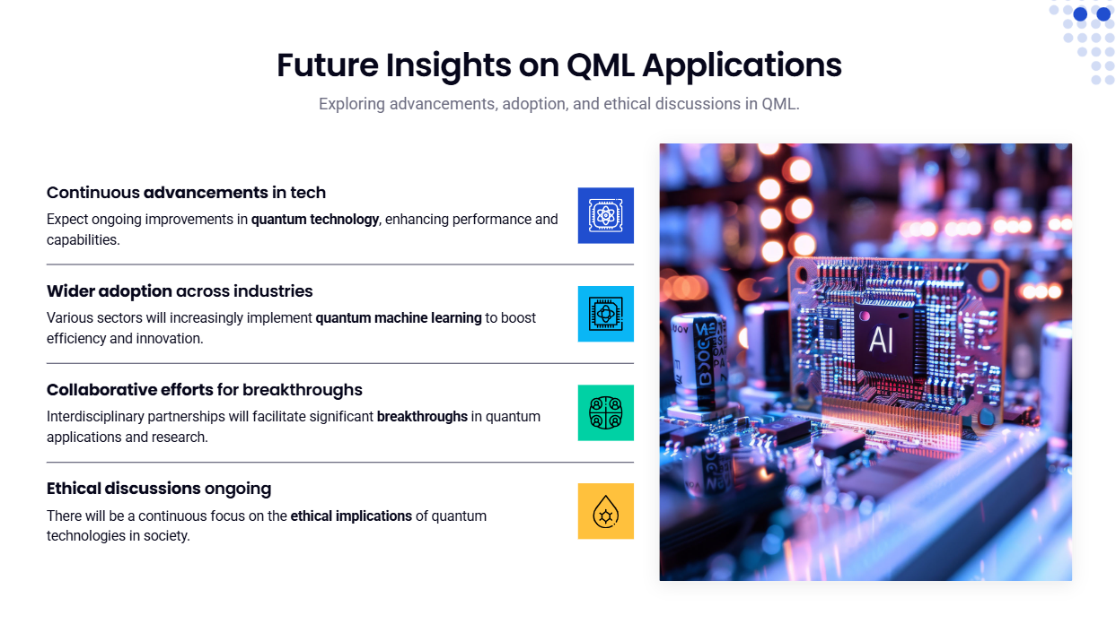

Slide 89
Outline
Case Study - QSVM on Iris Dataset
Dataset: IRIS
Encoding
Classifier : QSVM
Accuracy Comparison

Slide 90
IRIS DATASET :
The Iris dataset is a widely used dataset in machine learning, containing 150 samples from three Iris flower species: Setosa, Versicolor, and Virginica. Each sample includes four features — sepal length, sepal width, petal length, and petal width. It's mainly used for classification and pattern recognition tasks. The dataset is simple, well-balanced, and ideal for testing algorithms like SVM and QSVM.

Slide 91
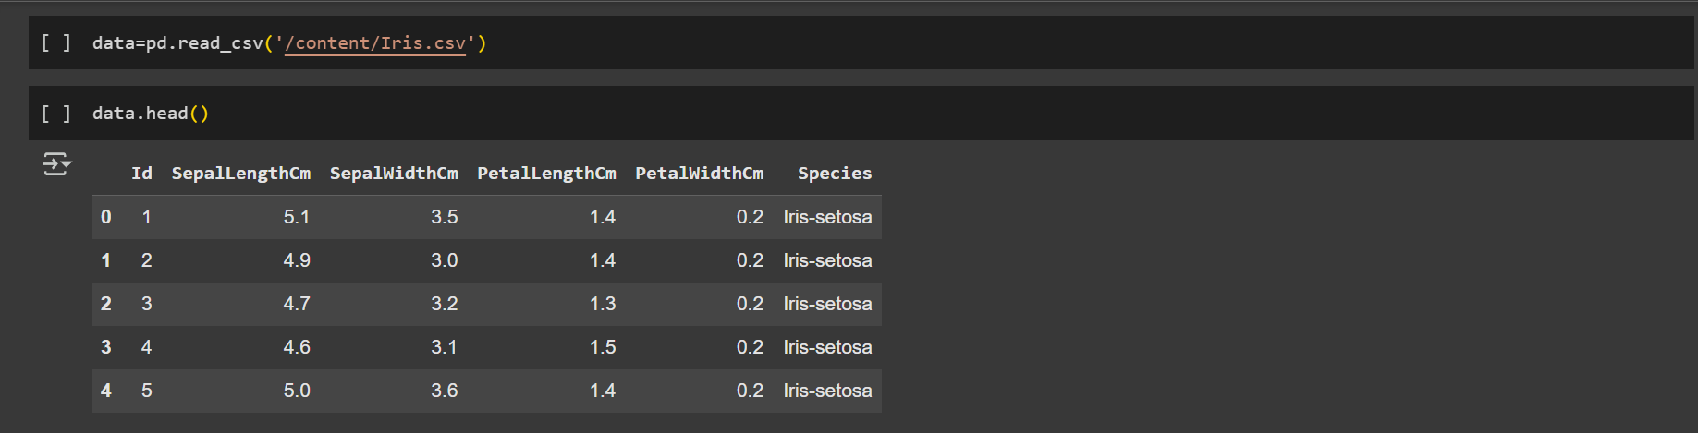

Slide 92
Encoding:
Angle Encoding
Angle Encoding (also called rotation encoding) is a method used to encode classical data into quantum states by applying rotation gates to qubits. It’s one of the simplest and most commonly used data encoding strategies in quantum machine learning.

Slide 93
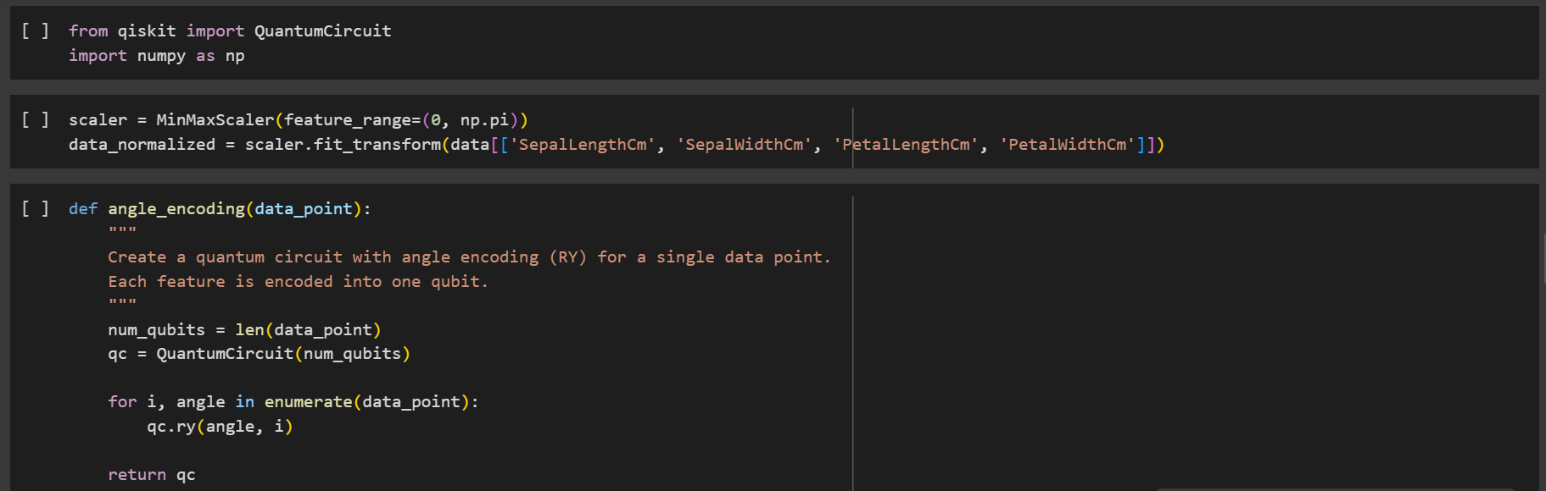
Code Snippet

Slide 94
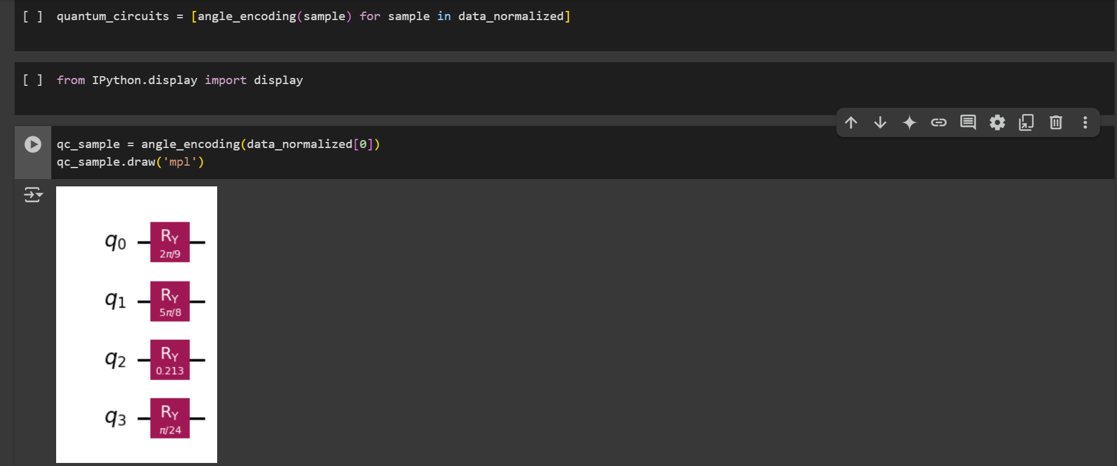

Slide 95
Classifier : QSVM
A QSVM is the quantum version of a classical SVM (Support Vector Machine), used for classification tasks in quantum machine learning. It uses quantum kernels to map data into high-dimensional Hilbert spaces via quantum circuits.

Slide 96
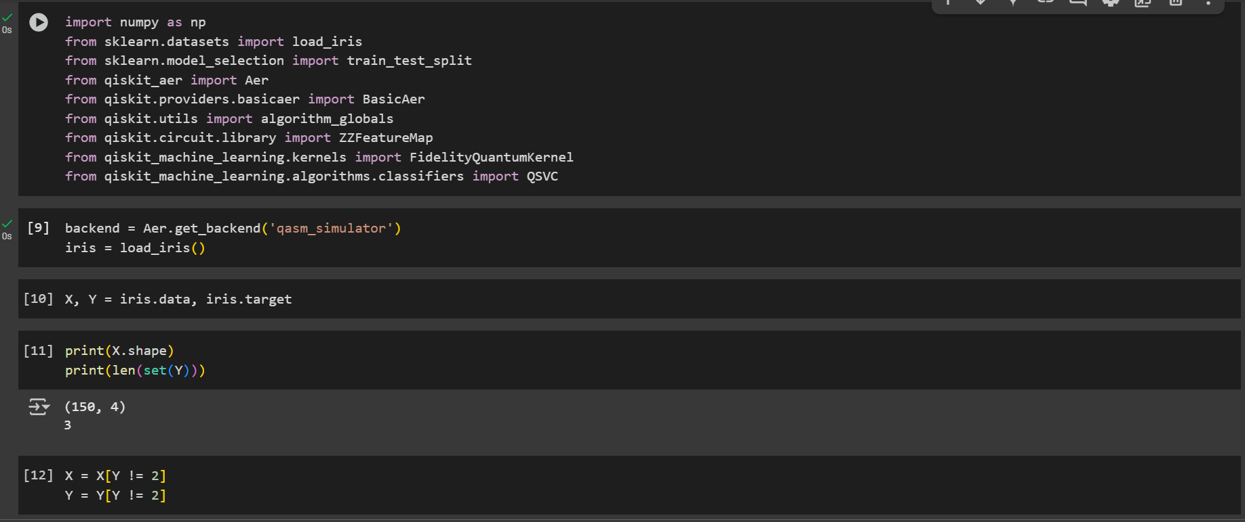
Code Snippets

Slide 97
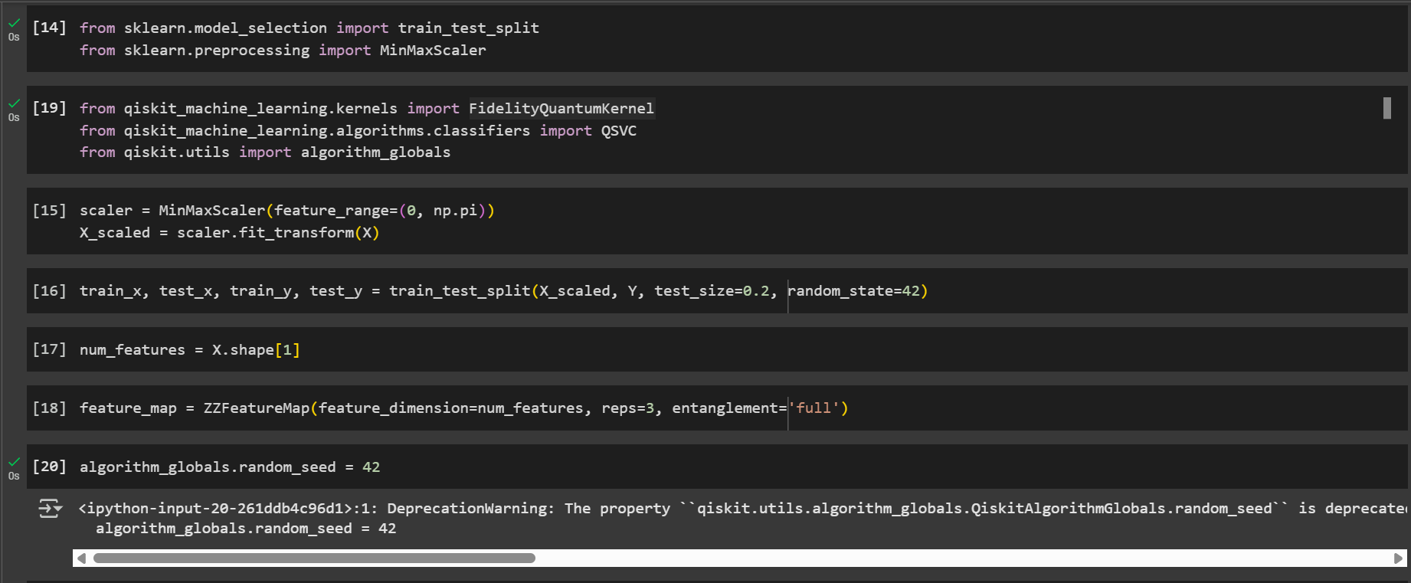

Slide 98
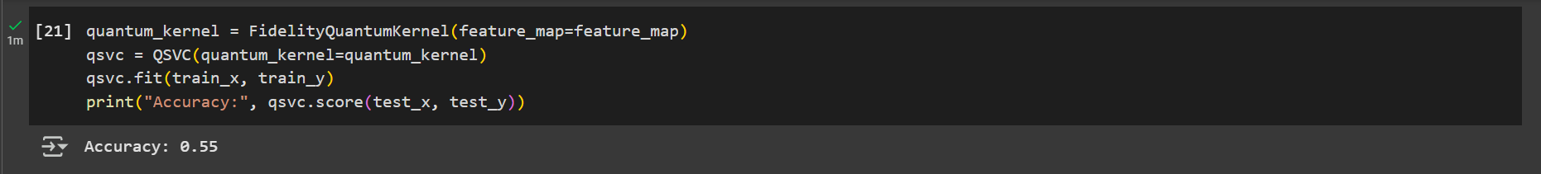
Final Output

Slide 99
Accuracy comparison:
Between Classical SVM and Quantum SVM

Slide 100


Slide 101

Result Plot

Slide 102
Future of QML

Slide 103
Toward fault-tolerant quantum learning
"Toward Fault-Tolerant Quantum Learning" refers to developing quantum machine learning (QML) algorithms and systems that remain accurate and reliable even in the presence of noise and errors, which are common in current quantum computers.
It focuses on designing quantum learning algorithms that are robust against errors using techniques like quantum error correction, noise-resilient circuits, and fault-tolerant architectures, so they can work effectively on near-term and future quantum devices.

Slide 104
Research areas: explainability, scaling
Explainability:
Focuses on making quantum algorithms, especially quantum machine learning, understandable to humans—explaining how and why a quantum model reaches a decision or prediction.
Scaling:
Involves developing hardware and algorithms that can grow to handle larger, more complex problems, including increasing qubit count, reducing error rates, and improving quantum circuit efficiency to make quantum computing practical at scale.

Slide 105
Visual: Roadmap For QML(2025 - 2030)

Slide 106


Slide 107


Slide 108


Slide 109


Slide 110


Slide 111
References
Peter Wittek, "Quantum Machine Learning"
Schuld & Petruccione, "Supervised Learning with Quantum Computers"
IBM Qiskit Tutorials
arXiv : Top papers on Quantum Computing

Slide 112

Thank You!!

Slide 113

Questions?

